Slide 1

Trac Networks
Presentation of TracSat

Slide 2
Challenge
Offshore and remote operations are undertaken in areas with limited - or even no local telecommunication infrastructure.
However, these remote operations require reliable connections to both their HQ-premises and the Internet
Solution
➔ TracSat
Provides Telecom-services independent of local infrastructure.
TracSat is a completely self-contained system providing IP-based services for both voice and data – into any remote location be offshore or onshore

Slide 3

Objectives - Why communication to remote sites-?
CPE HW Config.
Business objectives
TracSat
Subscriber
Operational
objectives
Competitive
Objectives
Add Service to
CPE at BS
System design

Slide 4

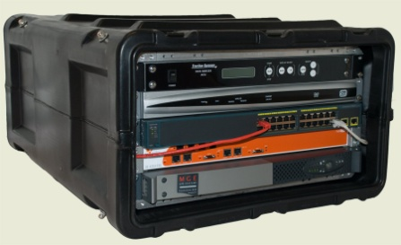
TracSat - Highlights
Easy to deploy and operate – wide coverage area
Access to company applications from remote sites
Pre-packed and pre-configured solution, ready to deploy
E-mail, Internet access and voice service
Prepared for Remote Management

Slide 5
TracSat
System performance
CPE HW Config.
Antenna system
TracSat
Subscriber
Bandwidth
utilization
Voice & Data
Services
Add Service to
CPE at BS

Slide 6
TracSat - Why better ?
System design
Antenna solution – designed to perform
Special system design for long delay / low bandwidth link
Satellite bandwidth utilization
Transmission and application parameters pre-configured
Toll quality voice
Voice / Internet connections from stable terrestrial network

Slide 7
TracSat
Deployment challenges
Local regulations for satellite systems
➔ To be addressed at an early stage
Satellite coverage ➔ Define actual telecom services
Integration into company’s IT-Systems ➔ ”Live” satellite test at home (prior to deploying equipment)
Planning is the key to success – as usual…

Slide 8
TracSat - Project Activities
Design Phase
Site Survey
Supply
Network upgrade Plan
Network upgrade
Build
Customer
Supplier
Supplier
Customer
Test, Commission
Handover/document.
Support
Procured Services

Slide 9
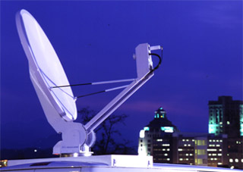

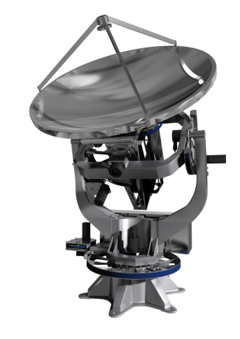
TracSat - Antenna System Options
Manual antenna – the ultimate low cost option
One-Button auto-acquisition antenna – for the convenience
Stabilized platform – the ultimative automatic antenna for Offshore Installations and production wessels / ships
Manual
Automatic
Stabilized

Slide 10
Coverage area - example
Newskies NSS-7@338deg.E (Ku-Band)
Hub: Jacksonville, Florida

Slide 11
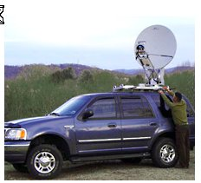
TracSat - Features
Easy to deploy and operate – no expert is required
All services provided are independant of local infrastructure
The satellite dish antenna may have automatic pointing
Internet & voice service from reliable backbone network
An UPS is isolating sensitive equipment from the mains

Slide 12

Mode of Operation
Standalone
Multi-node Operation
Remote Node #1
Remote Node #2
WiMax BS
Satellite Terminal
Remote Node #3
Remote Node #5
R=10km
Remote Node #4

Slide 13

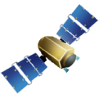

TracSat – Remote Site
Future version – additional capabilities
W
Wimax subscriber
Network Extension
10-15km
VHF/UHF Base Station
Tetra Base Station
VHF/UHF Tetra
WMax Base Station
Handsets
WLAN
TracSat Remote
LAN
Legend
Wireless
Wired

